Slide 1
www.cigionline.org

Slide 4
Headline
To bla dem ipsaperum quidel id et volupta tioreiuri
doloris ut voloribus est, te quis molupis vendam dit lantia volor modis
aspeditae. Itas doluptat qui dolestem ut accatur, et volo exerchi llorem eum ratium venem fugia serchicatur?
      Bullet point
      Bullet point
      Bullet point

Slide 7


Slide 8
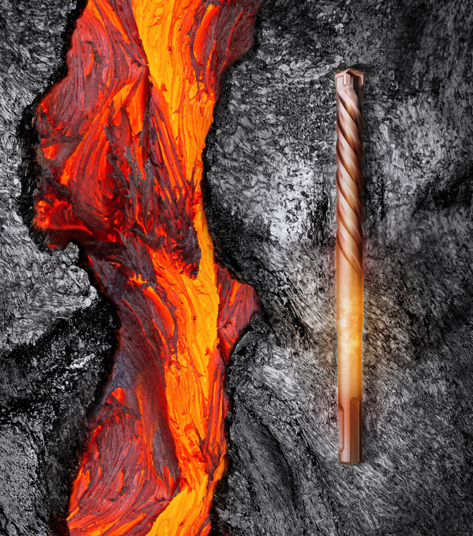

Slide 9
Bar charts

Slide 10
Tables
 | 2008 $ | 2009 $ | 2010 $ | 2011 $ | 2012 $
Content 1 | 12.345 | 12.345 | 12.345 | 12.345 | 12.345
Content 2 | 12.345 | 12.345 | 12.345 | 12.345 | 12.345
Content 3 | 12.345 | 12.345 | 12.345 | 12.345 | 12.345
Content 4 | 12.345 | 12.345 | 12.345 | 12.345 | 12.345
Content 5 | 12.345 | 12.345 | 12.345 | 12.345 | 12.345
Sum | 12.345 | 12.345 | 12.345 | 12.345 | 12.345
  Body Level 2
Notes:
Notes

Slide 11
Tables
 | 2008 $ | 2009 $ | 2010 $ | 2011 $ | 2012 $
Content 1 | 12.345 | 12.345 | 12.345 | 12.345 | 12.345
Content 2 | 12.345 | 12.345 | 12.345 | 12.345 | 12.345
Content 3 | 12.345 | 12.345 | 12.345 | 12.345 | 12.345
Content 4 | 12.345 | 12.345 | 12.345 | 12.345 | 12.345
Content 5 | 12.345 | 12.345 | 12.345 | 12.345 | 12.345
Sum | 12.345 | 12.345 | 12.345 | 12.345 | 12.345
  Body Level 2

Slide 13


Slide 14
www.cigionline.org

