Slide 1
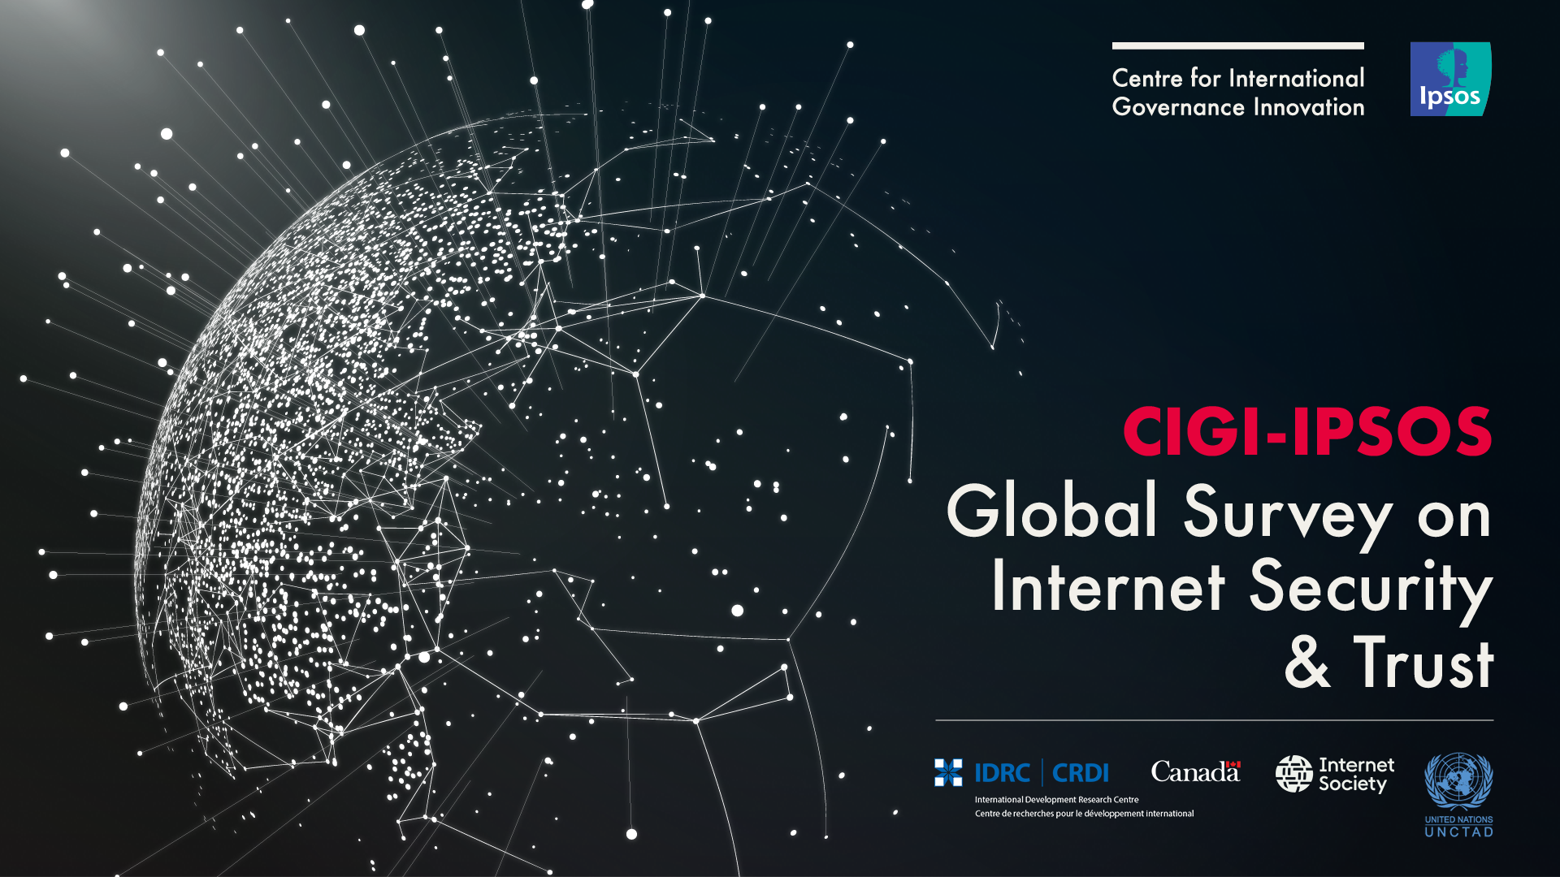

Slide 2
Methodology
This survey was conducted by Ipsos on behalf of the Centre for International Governance Innovation (“CIGI”) between December 23, 2016, and March 21, 2017.
The survey was conducted in 24 economies—Australia, Brazil, Canada, China, Egypt, France, Germany, Great Britain, Hong Kong (China), India, Indonesia, Italy, Japan, Kenya, Mexico, Nigeria, Pakistan, Poland, South Africa, South Korea, Sweden, Tunisia, Turkey and the United States—and involved 24,225 Internet users.
Twenty of the countries utilized the Ipsos Internet panel system while Tunisia was conducted via CATI, and Kenya, Nigeria and Pakistan utilized face-to-face interviewing, given online constraints in these countries and the length
In the US and Canada respondents were aged 18-64, and 16-64 in all other countries.
Approximately 1000+ individuals were surveyed in each country and are weighted to match the population in each country surveyed. The precision of Ipsos online polls is calculated using a credibility interval. In this case, a poll of 1,000 is accurate to +/- 3.5 percentage points. For those surveys conducted by CATI and face-to-face, the margin of error is +/-3.1, 19 times out of 20.
BIC = | Brazil, India, China
APAC = | Asia Pacific
LATAM = | Latin America

Slide 3
The Shared Economy

Slide 4
Two in ten global citizens are very likely to use a ride-sharing program, such as Uber, Lyft or Didi, in place of a normal taxicab
Q32. Many people in the “shared economy” use services such as Uber, where ordinary people sign up to effectively offer taxi services and get connected with people looking for rides via a mobile application. Please indicate how likely you are to do the following in the next year: Base: All Respondents (n=20,084)

Slide 5
Those in BIC and LATAM are most likely to use a ride-sharing program in the next year.
Q32. Many people in the “shared economy” use services such as Uber, where ordinary people sign up to effectively offer taxi services and get connected with people looking for rides via a mobile application. Please indicate how likely you are to do the following in the next year: Base: All Respondents (n=20,084)

Slide 6
One in ten say they’re very likely to become a driver for a ride-sharing service, led by those in India and Egypt.
Q32. Many people in the “shared economy” use services such as Uber, where ordinary people sign up to effectively offer taxi services and get connected with people looking for rides via a mobile application. Please indicate how likely you are to do the following in the next year: Base: All Respondents (n=20,084)

Slide 7
Those in BIC are the most likely to say they’ll sign up to be a driver for a ride-sharing service.
Q32. Many people in the “shared economy” use services such as Uber, where ordinary people sign up to effectively offer taxi services and get connected with people looking for rides via a mobile application. Please indicate how likely you are to do the following in the next year: Base: All Respondents (n=20,084)

Slide 8
A majority of global citizens believe that ride sharing services should be regulated similarly to taxis. Only in Germany, Poland and Japan does a majority not agree.
Q33. Do you agree or disagree that Uber and other ride-sharing services should be regulated similarly to taxis?
Base: All Respondents (n=20,084)

Slide 9
Ride sharing services should be regulated similarly to taxis - By Region
Q33. Do you agree or disagree that Uber and other ride sharing services should be regulated similarly to taxis?
Base: All Respondents (n=20,084)

Slide 10
PRIVACY & SECURITY

Slide 11
A majority of global citizens are more concerned about their online privacy compared to a year ago, led by those in LATAM and BIC. In most regions, the pace of growing concern is slowing year over year.
TOTAL CONCERNED
2016 | 2014
57% | 64%
63% | 81%
64% | 76%
59% | 67%
53% | 59%
60% | 69%
52% | 56%
50% | 51%
Q1. How concerned are you about your online privacy compared to one year ago?(Select one)
Base: All Respondents Total 2014 (n=23,376); Total 2016 (n=24,143), Total 2016 (n=24,225)

Slide 12
Among those more concerned, cyber criminals and internet companies are increasingly the sources of concern, but governments are also driving the increase in concern (both one’s own government and foreign governments), more so than last year.
A Great Deal / Somewhat
2016
79%
72%
66%
60%
n/a
57%
48%
Global Total
Q2. To what extent have the following sources contributed to your being more concerned than last year about your online privacy? Base: Much/ Somewhat More Concerned About Online Privacy 2016 (n=13,867); 2017 (n=12,926)

Slide 13
More (+5 points) say their own government is a contributing source of concern about their online privacy.
A Great Deal/Somewhat
2016
60%
69%
73%
73%
73%
79%
42%
72%
77%
60%
56%
73%
66%
62%
55%
71%
59%
50%
58%
61%
59%
29%
53%
43%
34%
*Not asked in China
Q2. To what extent have the following sources contributed to your being more concerned than last year about your online privacy? [Your Government] Base: Much/ Somewhat More Concerned About Online Privacy 2016 (n=13,867); 2017 (n=12,926)

Slide 14
TRUST IN THE INTERNET

Slide 15
While a majority trusts their ISP, banking platforms and search engines, very few strongly agree that they do. Only half trust their government to act responsibly online, and a minority trusts most foreign governments to act responsibly online. .
Global Total
Q7. To what extent do you agree or disagree with the following statements...
Base: All Respondents Total (n=24,225)

Slide 16
Trust in the internet is lowest in many advanced economics, such as Japan, South Korea, France and Germany.
Q7. To what extent do you agree or disagree with the following statements...
Base: All Respondents Total (n=24,225)

Slide 17
Trust in one’s own government to act responsibly online varies greatly, with Indonesia and India leading the pack, Mexico and South Korea lagging.
Q7. To what extent do you agree or disagree with the following statements...
Base: All Respondents Total (n=24,225)

Slide 18
Among those who distrust the internet, the leading reason is that they believe it is not secure, followed by the belief that it isn’t reliable.
Global Total
Q7a. Why do you disagree that you trust the Internet? (Select all that apply) Base: Those Who Distrust Internet (n=10,319)

Slide 19
Among those who distrust the internet, they are using the internet differently by disclosing less personal information online, taking greater care to secure their device, and using the internet more selectively.
Global Total
Q7b. How has your lack of trust in the Internet caused you to use the Internet differently? (Select all that apply)
Base: Those Who Distrust Internet (n=10,168)

Slide 20
ONLINE CHANGES IN BEHAVIOUR

Slide 21
Global citizens are most often avoiding opening emails from unknown sources, using antivirus software and avoiding certain internet sites. One in ten is making fewer online purchases. Just two in ten aren’t taking any precautions.
Total
Q3. How have you changed anything about how you behave online compared to one year ago? (Please select all that apply.)
Base: All Respondents Total 2014 (n=23,376); Total 2016 (n=24,143); Total 2017 (n=24,225)

Slide 22
Behaviour changes are most pronounced in LATAM.
 | Total | North America | LATAM | Europe | APAC | G-8 Countries | BIC | Middle East/Africa
 |  | A | B | C | D | E | F | G
Base: All Respondents | 24141 | 2000 | 2000 | 6000 | 7000 | 7000 | 3000 | 4023
Avoiding opening emails from unknown email addresses | 45% | 45% | 52% | 46% | 45% | 43% | 40% | 42%
Using antivirus software | 38% | 35% | 50% | 35% | 40% | 32% | 45% | 39%
Avoiding certain Internet sites | 37% | 36% | 54% | 34% | 31% | 31% | 38% | 41%
Changing your password regularly | 31% | 30% | 40% | 28% | 35% | 27% | 35% | 33%
Avoiding certain web applications | 31% | 28% | 42% | 26% | 27% | 22% | 34% | 33%
Cutting down on the amount of biographically accurate information you divulge online | 29% | 25% | 37% | 28% | 30% | 23% | 28% | 27%
Self-censoring what you say online | 22% | 23% | 22% | 14% | 22% | 17% | 21% | 23%
Doing fewer financial transactions online | 15% | 12% | 23% | 10% | 16% | 10% | 20% | 17%
Changing who you communicate with | 14% | 13% | 15% | 8% | 13% | 8% | 16% | 14%
Making fewer on-line purchases | 13% | 12% | 18% | 9% | 12% | 9% | 16% | 18%
Closing Facebook and other social media accounts, etc. | 10% | 12% | 10% | 7% | 9% | 8% | 12% | 11%
Using the Internet less often | 9% | 7% | 10% | 4% | 6% | 4% | 11% | 10%
None of these | 19% | 25% | 9% | 24% | 16% | 28% | 9% | 18%
Q3. How have you changed anything about how you behave online compared to one year ago? (Please select all that apply.)
Base: All Respondents Total 2017 (n=24,225)

Slide 23
Other changes in online behavior include avoiding clicking on unknown links, using more privacy settings, and updating their software more regularly. But some are becoming more active online, such as using it more for entertainment, business, and making more online purchases.
Total
Q4. How else have you changed your behavior? (Please select all that apply.)
Base: All Respondents Total 2017 (n=24,225)

Slide 24
LATAM, BIC and Middle/East African residents appear most likely to be changing their behaviour.
 | Total | North America | LATAM | Europe | APAC | G-8 Countries | BIC | Middle East/Africa
 |  | A | B | C | D | E | F | G
Base: All Respondents | 24141 | 2000 | 2000 | 6000 | 7000 | 7000 | 3000 | 4023
Avoiding clicking on unknown links in messages | 45% | 48% | 58% | 45% | 44% | 41% | 46% | 45%
Using more privacy settings | 32% | 31% | 41% | 25% | 35% | 24% | 41% | 36%
More regular updating of software | 28% | 24% | 31% | 25% | 27% | 22% | 29% | 30%
Using the Internet more for entertainment | 23% | 18% | 28% | 15% | 18% | 14% | 26% | 31%
Using the Internet more for social interaction | 18% | 11% | 19% | 9% | 15% | 8% | 22% | 25%
Using the Internet more for business or professional work | 16% | 9% | 21% | 7% | 17% | 6% | 22% | 22%
Using two-factor authentication | 14% | 12% | 14% | 9% | 22% | 9% | 18% | 13%
Using encrypted communications services | 14% | 7% | 18% | 9% | 18% | 7% | 21% | 14%
Making more on-line purchases | 13% | 14% | 11% | 12% | 16% | 12% | 23% | 9%
Using a VPN (virtual private network) | 10% | 6% | 14% | 7% | 11% | 5% | 12% | 13%
None of these | 22% | 26% | 11% | 29% | 19% | 33% | 11% | 17%
Q4. How else have you changed your behavior? (Please select all that apply.)
Base: All Respondents Total 2017 (n=24,225)

Slide 25
ONLINE SHOPPING BEHAVIOUR

Slide 26
More say it is getting easier (42%), not harder (9%), to buy goods and services online. Similar trends are found when it comes to accessing websites in a quick manner, relying on sites to be online and working, and various other issues of access.
2016 Easier
-
46%
45%
-
42%
39%
38%
35%
36%
-
29%
-
Global Total
Q5. Compared to one year ago, would you say that it is easier or harder to do the following things on the internet:
Base: All Respondents Total (n=23,291)

Slide 27
Those in LATAM, BIC and the Middle East and Africa are most likely to say it is becoming easier to buy goods and services online.
Q5. Compared to one year ago, would you say that it is easier or harder to do the following things on the internet: [Buying goods and services online] Base: All Respondents Total (n=23,291)

Slide 28
Six in ten (57%) global residents are likely to use mobile payment systems on their smartphone in the next year. Just 8% of internet users say they don’t own a smartphone.
TOTAL LIKELY
57%
TOTAL NOT LIKELY
35%
Q14. How likely are you to use mobile payment systems on your smartphone in the next year?
Base: All Respondents Total 2017 (n=24,225)

Slide 29
Propensity to use online payment systems on mobile phones varies greatly by country, with most G-8 countries near the bottom of the list, and emerging economies near the top. o
% likely to use mobile payments
Q14. How likely are you to use mobile payment systems on your smartphone in the next year?
Base: All Respondents Total 2017 (n=24,225)

Slide 30
Only 22% of online global citizens say they never buy goods or services online.
Q15. How frequently do you buy goods or service online?
Base: All Respondents (23,291)

Slide 31
Two of the highest growth economies – China and India – are among the most frequent online purchasers.
Q15. How frequently do you buy goods or service online?
Base: All Respondents (23,291)

Slide 32
Among those who never shop online, the key reason they do not is a lack of trust.
Q16. Why do you not purchase goods or service online?
Base: Never Buy Goods or Services Online (n=4,565)

Slide 33
Lack of trust appears to be a bigger roadblock for Middle East, African and LATAM countries.
Q16. Why do you not purchase goods or service online?
Base: Never Buy Goods or Services Online (n=4,565)

Slide 34
Among those who shop online, saving time, convenience, ease of use, flexibility of prices, a wide range of choices, and the ability to buy items they can’t get elsewhere drive this behaviour.
Q17. Why do you shop online?
Base: Buy Goods or Services Online At Least Once Month (n=18,551)

Slide 35
Among those who shop online, credit cards and electronic payments like PayPal are the preferred means of paying for those goods and services. Just 3% prefer cryptocurrencies as a method of payment.
Q18. What is your preferred way of paying for goods and services bought online?
Base: Buy Goods or Services Online At Least Once Month (n=18,551)

Slide 36
Those in Tunisia, Indonesia and Mexico are the most likely online shoppers to prefer paying with cryptocurrencies such as Bitcoin.
Q18. What is your preferred way of paying for goods and services bought online? [Cryptocurrencies (Bitcoin) ]
Base: Buy Goods or Services Online At Least Once Month (n=18,551)

Slide 37
Most consumers agree that the origin of the good or service affects what they buy
TOTAL AGREE
82%
TOTAL DISAGREE
18%
Q20. Do you agree or disagree that when shopping online, where the good or service is made affects what you buy?
Base: Buy Goods or Services Online at Least Once Month (n=18,551)

Slide 38
Among those who say the origin affects what they buy, the primary reason is that they prefer products made in their own country. in their own country.
Q21. Why does the origin of where the good or service is made affect what you buy?
Base: Those who say origin of goods/services impacts decision (n=14,896)

Slide 39
Those in Tunisia, South Korea, Japan and Germany are most likely to prefer goods and services that are from their own country. Those in Hong Kong (China) and Egypt don’t feel the same way.
Q21. Why does the origin of where the good or service is made affect what you buy? [I prefer products made in my country]
Base: Those who say origin of goods/services impacts decision (n=14,896)

Slide 40
ONLINE SHOPPING REGULATION & SECURITY

Slide 41
Consumers deem every type of protection mechanism as being important, with at least half saying each is very important.
Important
94%
94%
94%
93%
91%
87%
Q19. How important are the following regulations or protections in determining whether you will engage in online shopping?
Base: Buy Goods or Services Online At Least Once Month (n=18,551)

Slide 42
Most say they would be likely to stop using an online service as a result of a data breach, regardless of what information was lost, but only a minority is “very likely” to do so.
Very/Somewhat Likely
76%
75%
74%
74%
72%
Q27. If the following happened, how likely would you be to stop using the online service as a result?
Base: All Respondents (n=24,225)

Slide 43
While only slightly more say they’d be very/somewhat likely to stop using the service after a second data breach, the intensity has strengthened with a majority saying they’re “very likely” to stop using the service after a second breach.
Very/Somewhat Likely
80%
80%
79%
79%
79%
Q28. And If the following happened for a second time, how likely would you be to stop using the online service as a result?
Base: All Respondents (n=24,225)

Slide 44
Contacts
Fen Hampson
CIGI Distinguished Fellow
Director of the Global Security & Politics Program
Centre for International Governance Innovation
Sean Simpson
Vice President
Ipsos Public Affairs
fhampson@cigionline.org
Sean.Simpson@ipsos.com
+1 519 885 2444 ext. 7201
+1 416 324 2002

Slide 45
ABOUT CIGI
We are the Center for International Governance Innovation: an independent, non-partisan think tank with an objective and uniquely global perspective. Our research, opinions and public voice make a difference in today's world by bringing clarity and innovative thinking to global policy making. By working across disciplines and in partnership with the best peers and experts, we are the benchmark for influential research and trusted analysis.
Our research programs focus is governance of the global economy , global security and politics , and international law in cooperation with a Range of strategic partners and the support from the Government of Canada, the Government of Ontario, as well as founder Jim Balsillie.
Sponsors
CIGI would like to recognize and thank the following sponsors for their generous support which facilitated the work done within the CIGI-Ipsos Global Survey on Internet Security & Trust.
  International Development Research Centre (IDRC)
  Internet Society
  United Nations Conference on Technology and Development (UNCTAD)

